Slide 1
Paragraph Writing
Muhammad Talha Bin Latif
Lecturer, Iqra University Islamabad

Slide 2
Topic Sentence
What is the topic sentence?
The topic sentence is the first sentence in a paragraph.
What does it do?
It introduces the main idea of the paragraph.
How do I write one?
Summarize the main idea of your paragraph. Indicate to the reader what your paragraph will be about.

Slide 3
Example:
There are three reasons why Canada is one of the best countries in the world. First, Canada has an excellent health care system. All Canadians have access to medical services at a reasonable price. Second, Canada has a high standard of education. Students are taught by well-trained teachers and are encouraged to continue studying at university. Finally, Canada's cities are clean and efficiently managed. Canadian cities have many parks and lots of space for people to live. As a result, Canada is a desirable place to live.

Slide 4
Supporting Details
What are supporting sentences?
They come after the topic sentence, making up the body of a paragraph.
What do they do?
They give details to develop and support the main idea of the paragraph.
How do I write them?
You should give supporting facts, details, and examples.

Slide 5
Example:
There are three reasons why Canada is one of the best countries in the world. First, Canada has an excellent health care system. All Canadians have access to medical services at a reasonable price. Second, Canada has a high standard of education. Students are taught by well-trained teachers and are encouraged to continue studying at university. Finally, Canada's cities are clean and efficiently managed. Canadian cities have many parks and lots of space for people to live. As a result, Canada is a desirable place to live.

Slide 6
Closing Sentence
What is the closing sentence?
The closing sentence is the last sentence in a paragraph.
What does it do?
It restates the main idea of your paragraph.
How do I write one?
Restate the main idea of the paragraph using different words.

Slide 7
Example:
There are three reasons why Canada is one of the best countries in the world. First, Canada has an excellent health care system. All Canadians have access to medical services at a reasonable price. Second, Canada has a high standard of education. Students are taught by well-trained teachers and are encouraged to continue studying at university. Finally, Canada's cities are clean and efficiently managed. Canadian cities have many parks and lots of space for people to live. As a result, Canada is a desirable place to live.

Slide 8
Prewriting Paragraphs
What is the prewriting stage? The prewriting stage is when you think carefully and organize your ideas for your paragraph before you begin writing.

Slide 9
Six Prewriting Steps:
1. Think carefully about what you are going to write. Ask yourself: What question am I going to answer in this paragraph or essay? How can I best answer this question? What is the most important part of my answer? How can I make an introductory sentence (or thesis statement) from the most important part of my answer? What facts or ideas can I use to support my introductory sentence? How can I make this paragraph or essay interesting? Do I need more facts on this topic? Where can I find more facts on this topic?

Slide 10
Six Prewriting Steps:
2. Open your notebook. Write out your answers to the above questions. You do not need to spend a lot of time doing this; just write enough to help you remember why and how you are going to write your paragraph or essay.
3. Collect facts related to your paragraph or essay topic. Look for and write down facts that will help you to answer your question. Timesaving hint: make sure the facts you are writing are related to the exact question you are going to answer in your paragraph or essay.

Slide 11
Six Prewriting Steps:
4. Write down your own ideas. Ask yourself: What else do I want to say about this topic? Why should people be interested in this topic? Why is this topic important?
5. Find the main idea of your paragraph or essay. Choose the most important point you are going to present. If you cannot decide which point is the most important, just choose one point and stick to it throughout your paragraph or essay.

Slide 12
Six Prewriting Steps:
6. Organize your facts and ideas in a way that develops your main idea. Once you have chosen the most important point of your paragraph or essay, you must find the best way to tell your reader about it. Look at the facts you have written. Look at your own ideas on the topic. Decide which facts and ideas will best support the main idea of your paragraph. Once you have chosen the facts and ideas you plan to use, ask yourself which order to put them in the paragraph. Write down your own note set that you can use to guide yourself as you write your paragraph or essay.

Slide 13
Writing Paragraphs
What is the writing stage?
The writing stage is when you turn your ideas into sentences.

Slide 14
Five Writing Steps:
1. Open your notebook and word processor.
2. Write the topic sentence, supporting
sentences, and closing sentence.
3. Write clear and simple sentences to
express your meaning.
4. Focus on the main idea of your paragraph.
5. Use the dictionary to help you find
additional words to express your ideas.

Slide 15
Editing Paragraphs
What is the editing stage?
The editing stage is when you check your paragraph for mistakes and correct them.

Slide 16
Grammar and Spelling
1. Check your spelling.
2. Check your grammar.
3. Read your essay again.
4. Make sure each sentence has a subject.
5. See if your subjects and verbs agree with
each other.
6. Check the verb tenses of each sentence.
7. Make sure that each sentence makes sense.

Slide 17
Style and Organization
Make sure your paragraph has a topic sentence.
Make sure your supporting sentences focus on the main idea.
Make sure you have a closing sentence.
Check that all your sentences focus on the main idea.
See if your paragraph is interesting.

Slide 18
Kinds of Sentences and Their Punctuation
http://www.towson.edu/ows/sentences.htm

Slide 19
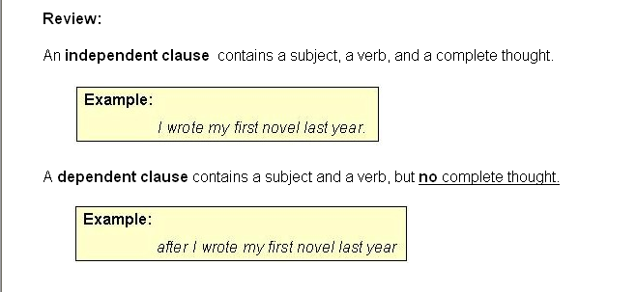
A sentence may be one of four kinds, depending upon the number and type(s) of clauses it contains.

Slide 20
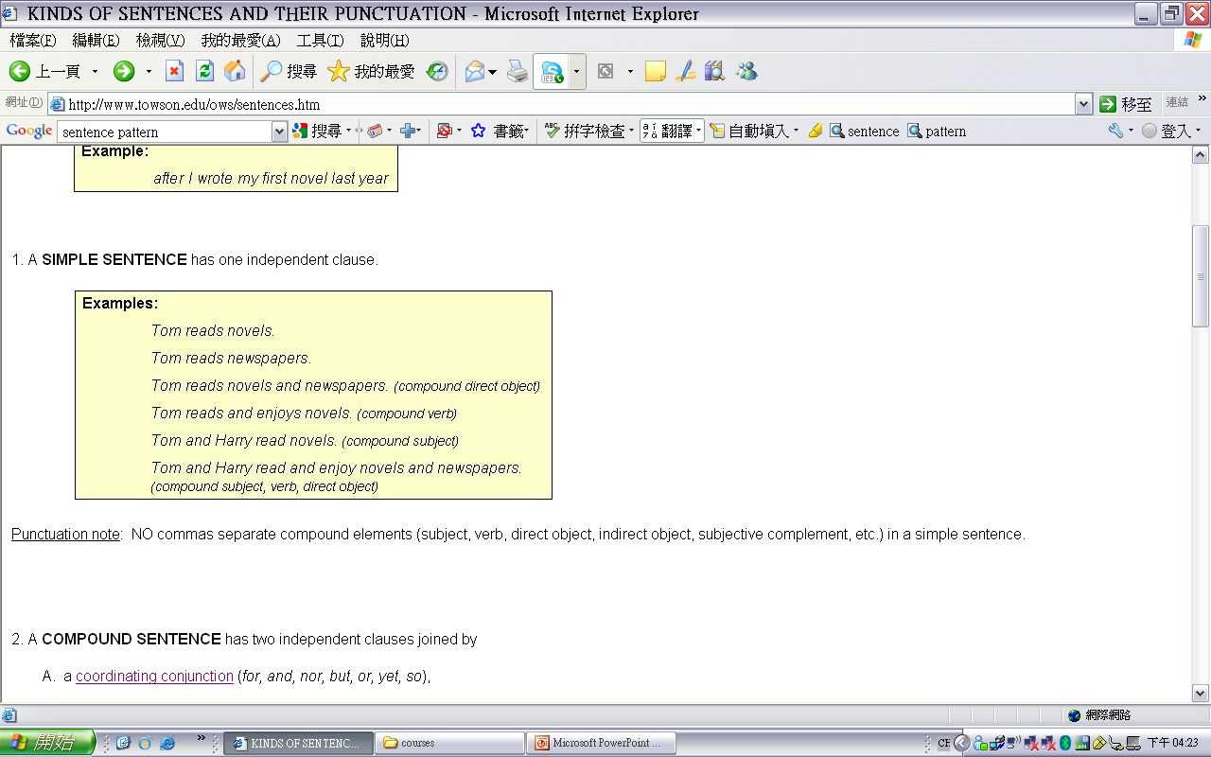

Slide 21
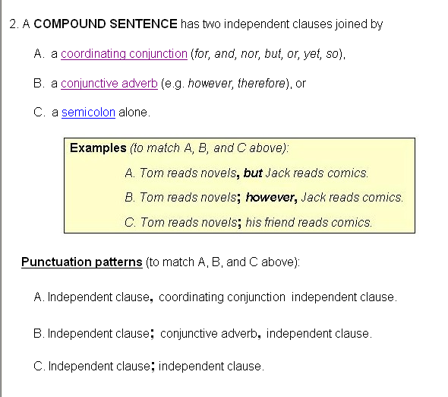

Slide 22
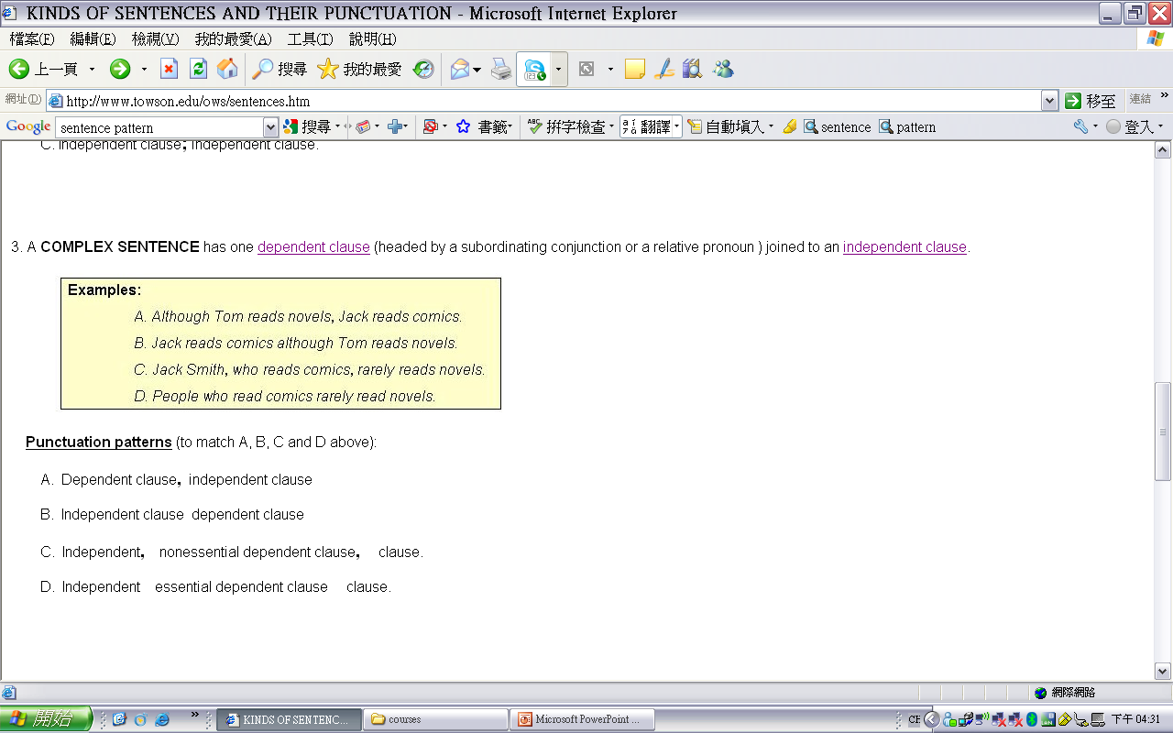

Slide 23
